Slide 1
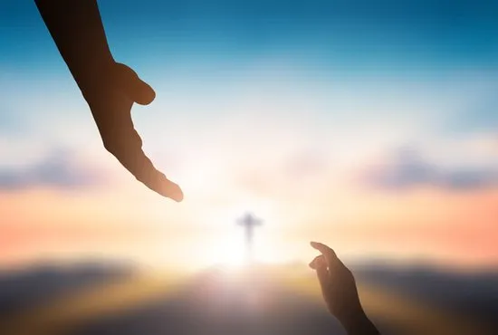
Celebrating Christ’s Mercy
SSJ First Sacraments Retreat 2023

Slide 2

Original Sin

Slide 3
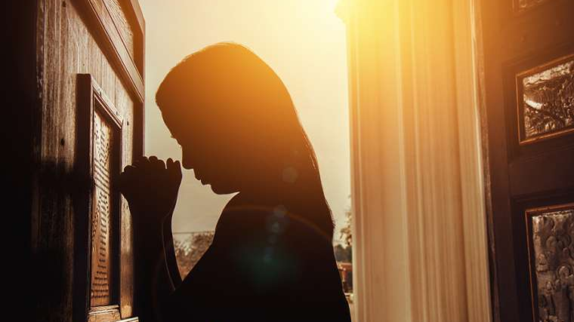
Sacrament of Reconciliation

Slide 4
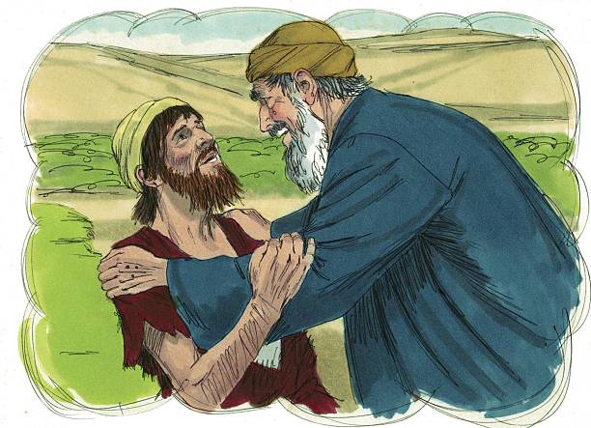
The Prodigal Son

Slide 5
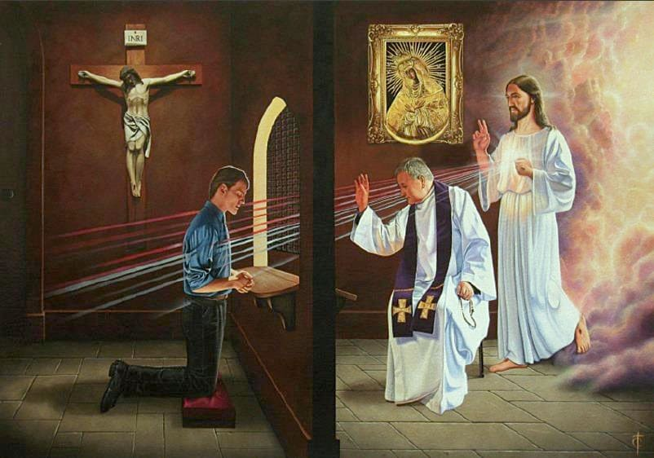
Four elements of a good confession

Slide 6
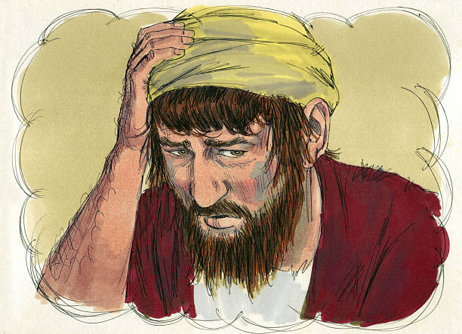
CONTRITION
SORROW FOR OUR SINS

Slide 7
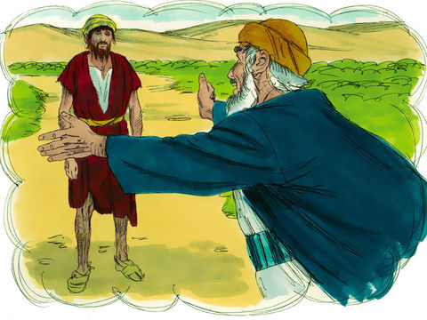
Confession
Saying “I’m Sorry”

Slide 8
ABSOLUTION
RECEIVING GOD’S FORGIVENESS

Slide 9
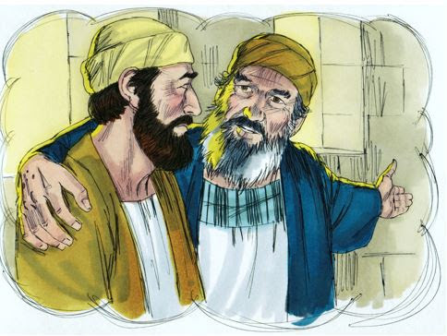
PENANCE
MAKING AMMENDS

Slide 10
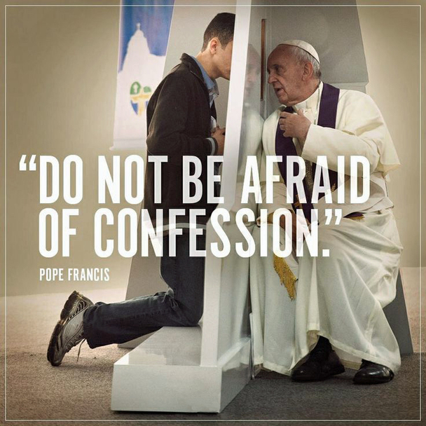

Slide 11
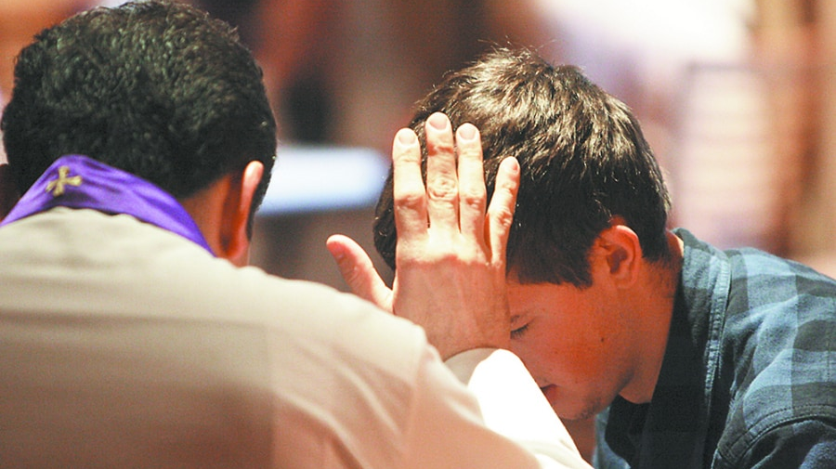
Reconciliation Role-Play

Slide 12

break

Slide 13
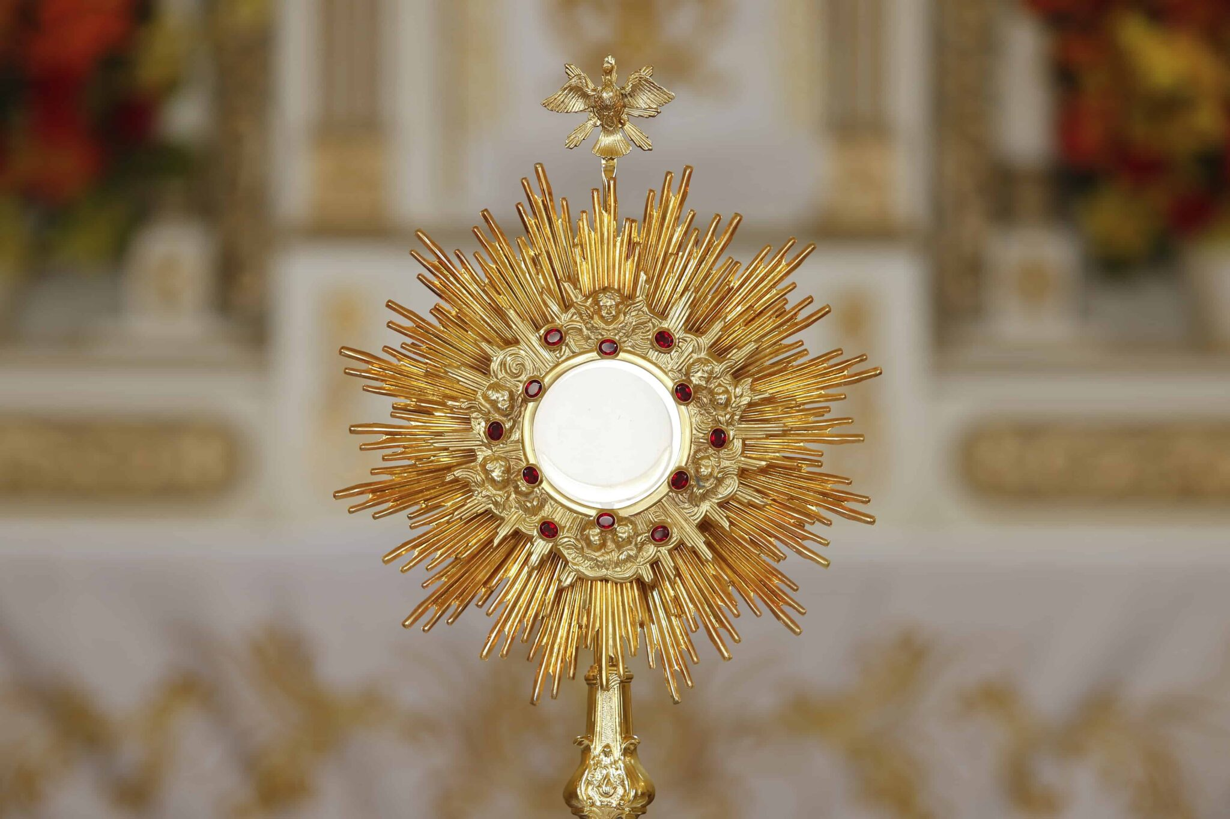
Celebrating Christ’s Presence
SSJ First Sacraments Retreat 2023

Slide 14
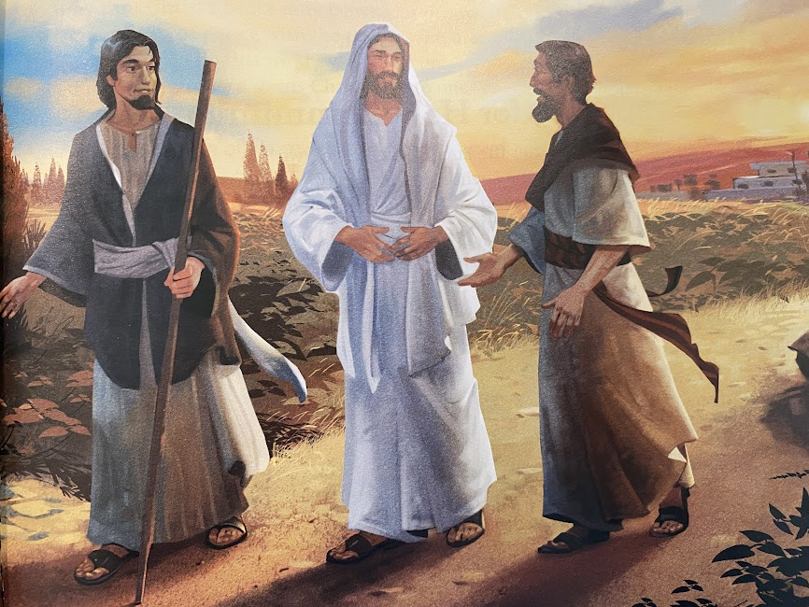
THE ROAD TO EMMAUS

Slide 15

Video

Slide 16
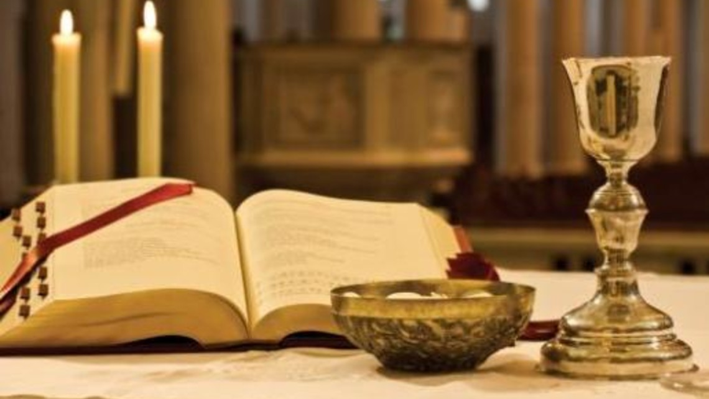
THE FOUR PARTS OF THE MASS

Slide 17
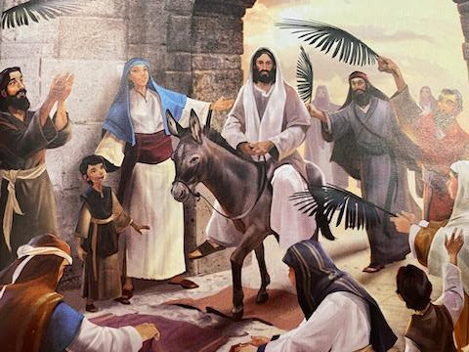
INTRODUCTORY RITE
WE GIVE PRAISE AND GLORY TO GOD!

Slide 18
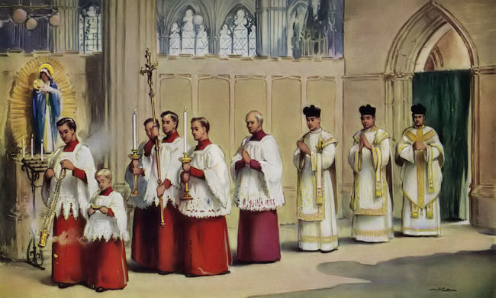

Slide 19
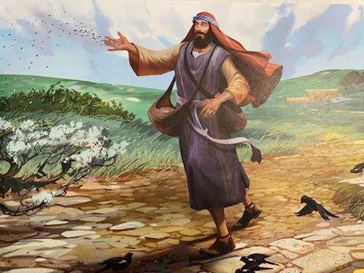
The liturgy of the word we listen to the word of god
Old Testament Reading
Psalm
New Testament Reading
Gospel
Homily

Slide 20
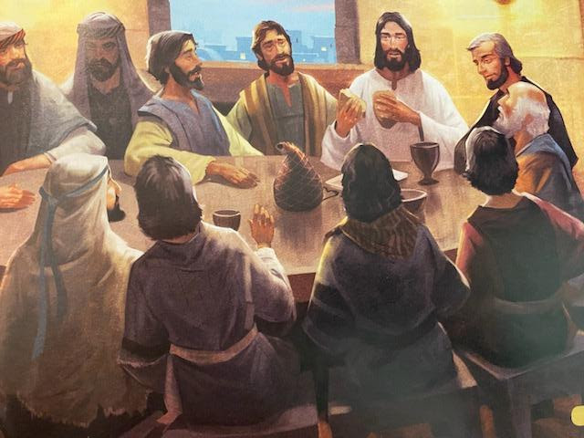
The liturgy of the Eucharist
WE PREPARE OUR HEARTS AND MINDS TO RECEIVE JESUS

Slide 21
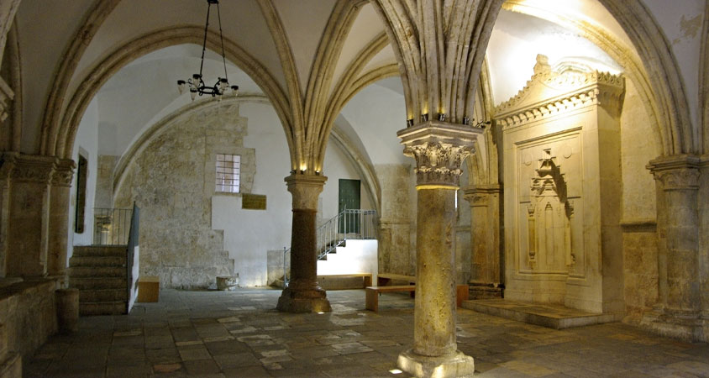
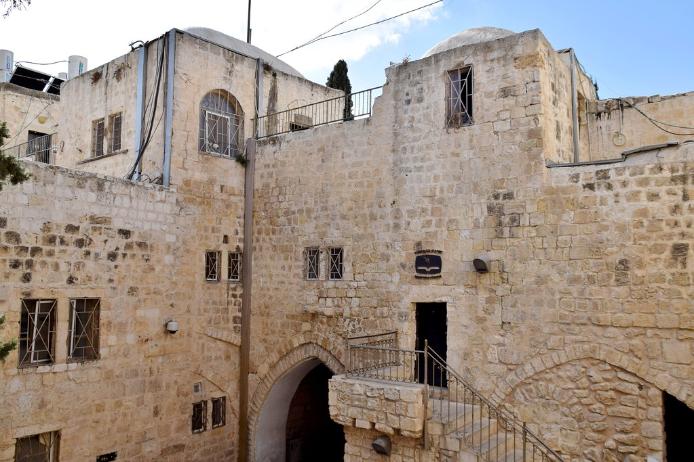

Slide 22
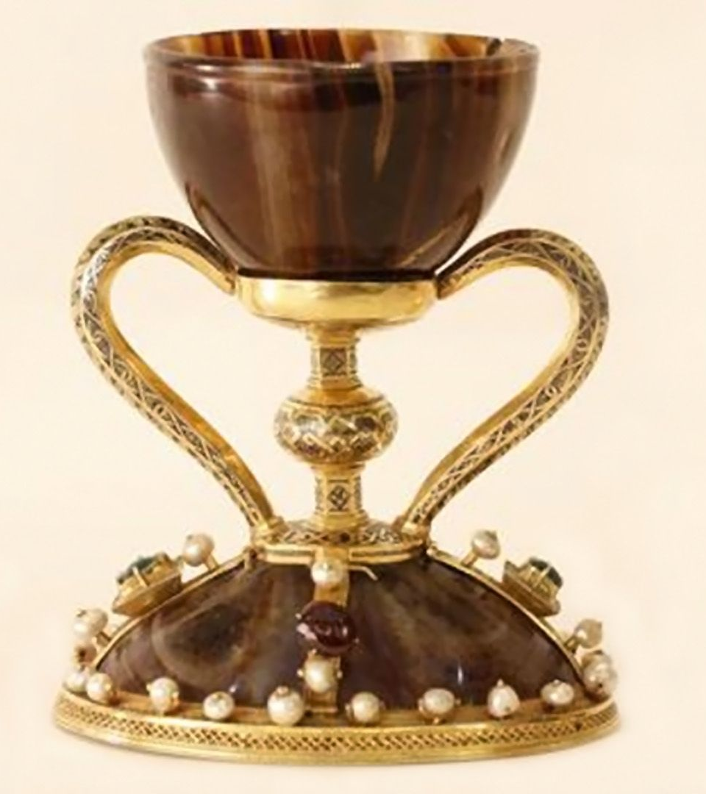
The chalice of valencia

Slide 23
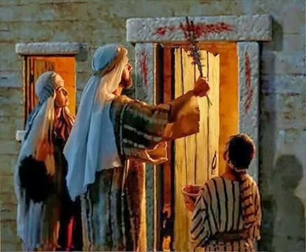
Passover

Slide 24
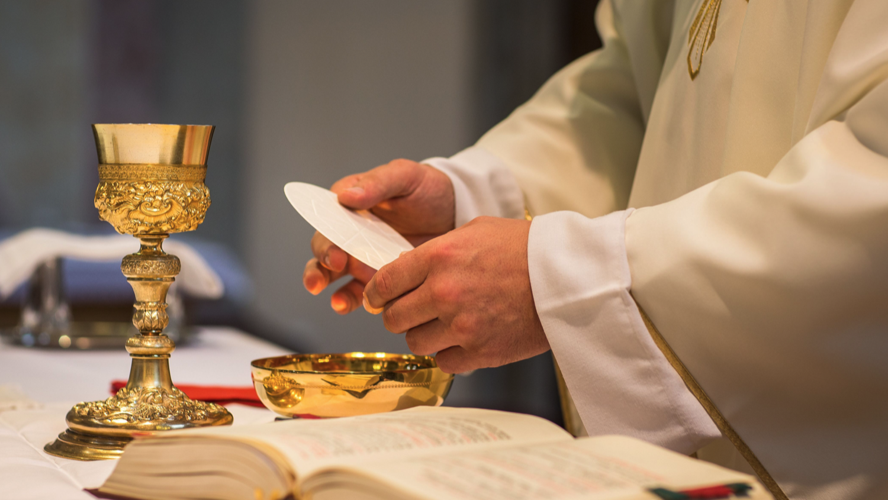

Slide 25
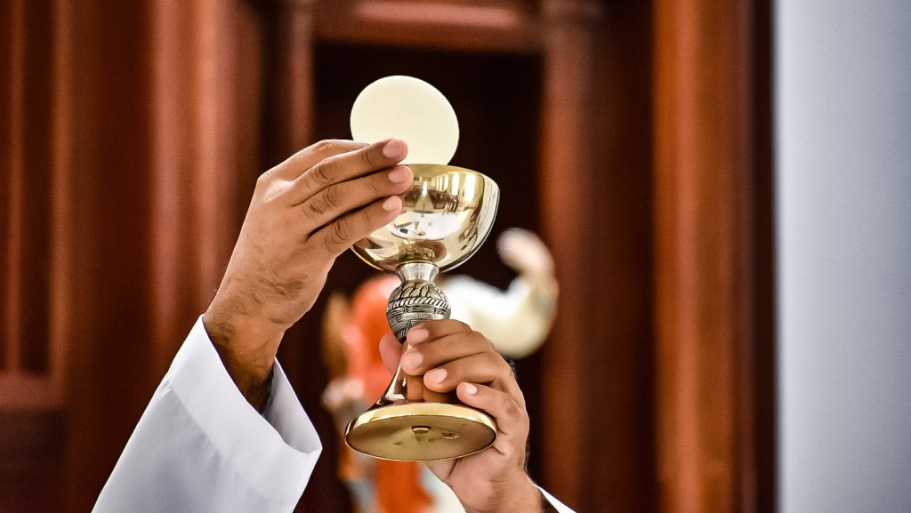

Slide 26
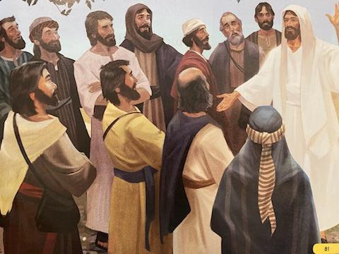
The concluding rite
We go forth proclaiming the good news!

Slide 27
break

Slide 28
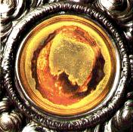
Lanciano, Italy
8th Century A.D.

Slide 29
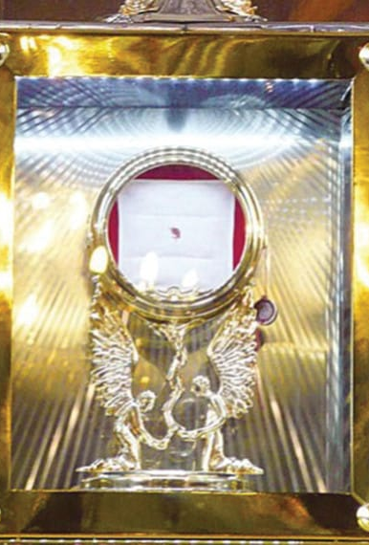
Legnica, Poland
2013 A.D.

Slide 30
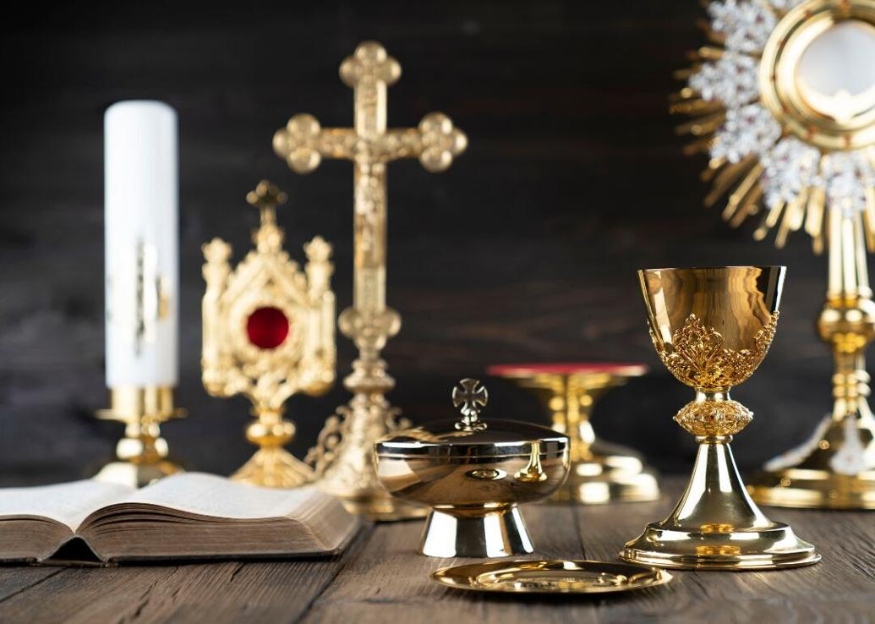
Sacred vessels and mass objects

Slide 31
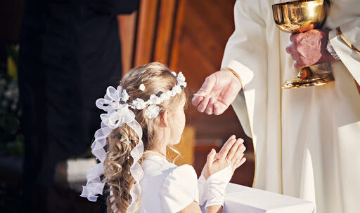
PRACTICE RECEIVING COMMUNION

Slide 32


Slide 33
Closing Prayer
Lord Jesus Christ,
Bless these children preparing to receive Holy Communion for the first time.
May this day be a step toward a life-long love of the Eucharist.
Give them a hunger for this sacred food so that they turn to you for comfort, guidance, and wisdom as they grow into full discipleship.
Thank you for their innocence and goodness.
May their hands, extended in anticipation of your body and blood, inspire all of us to cherish this sacred Sacrament. Amen.

